Slide 1
UNIT V
MEMORY AND PROGRAMMABLE LOGIC

Slide 2
Introduction
Memory unit : a collection of cells capable of storing a large quantity of
binary information
: Store and Retrieve information
:Write and Read Operation
Data processing : Information from memory is transferred to selected
registers in the processing unit
: Intermediate and final results obtained in the processing unit
are transferred back to stored in memory
Information : received from an input device is stored in memory
:transferred to an output device is taken from memory

Slide 3
Introduction
Types of memories
1. Random-Access Memory (RAM)
Operating system
Application programs
Data in current use
All these resides in RAM for quick reach by processor
2. Read-Only Memory (ROM)
As fast as RAM,
Cannot change the content
Retains its contents even when shut off
Used to start your computer up and load the operating system into RAM
Can be used as PLD

Slide 4
Introduction
Types of memories
Random‐access memory (RAM) : Read/Write
Read‐only memory (ROM) : Read
Mask Programming
PROM
EPROM
EEPROM
Flash Memory
Memory write operation : Process of transferring new information into memory
Memory read operation : Process of transferring information out of memory

Slide 5
RAM
Memory unit –
Collection of storage cells
With associated circuits to R/W
Stores binary information in groups of bits called words
A word is a group of bits that move in and out of storage as a unit
A group of 8 bits is called a byte
Most computer memories use words that are multiples of 8 bits in length
16‐bit word = 2 bytes
32‐bit word = 4 bytes
may represent a number, character(s), instruction, or other binary-coded information
The capacity of a memory unit is usually stated as the total number of bytes that the unit can store

Slide 6
RAM
RAM can selectively retrieved information from any of its internal locations
The time it takes to transfer information to or from any desired random location is always the Same
Hence the name random‐access memory
Note: The time required to retrieve information that is stored on magnetic tape depends on the location of the data

Slide 7
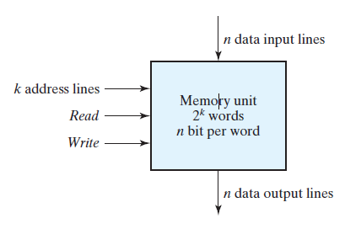
RAM
Communication is through
Data input and output lines
Address selection lines
Control lines that specify
the direction of transfer
Block diagram
n data input lines and output lines
k address lines specify the particular word
2 control inputs specify the direction of transfer
Write input causes binary data to be transferred into the memory
Read input causes binary data to be transferred out of memory

Slide 8
RAM
Word - assigned an identification number, called an address
The address lines select the word to R/W
Selection is done by applying the k ‐bit address to the address lines
An internal decoder accepts this address and opens the paths needed to select the word specified
k is the number of address lines refer 0 to 2^{k} – 1 different words
Memory is referred in number of words (or bytes)
K (kilo), M (mega), and G (giga)
K is equal to 2¹⁰,
M is equal to 2²⁰, and
G is equal to 2³⁰

Slide 9
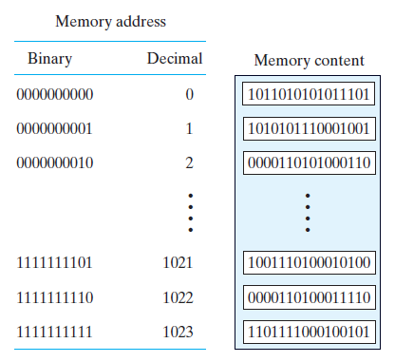
RAM
Example Memory unit
Capacity 1K words of 16 bits (2 bytes)
1K = 1,024 = 2¹⁰
16 bits = 2 bytes
It can accommodate
1024*2= 2,048 = 2K bytes

Slide 10
RAM - Write and Read Operations
To transfer a new word into memory:
1. Place the address in the address lines
2. Place the data input in the data line
3. Activate the write control signal
To transfer a stored word out of memory:
1. Place the address in the address lines
2. Activate the read control signal
3. Data output will be in the data line

Slide 11
RAM - Timing Waveforms
The operation of the memory unit is controlled by central processing unit (CPU)
The CPU is usually synchronized by its own clock
The memory, however, does not employ an internal clock
The access time of memory is the time required to select a word and read it
The cycle time of memory is the time required to complete a write operation
The CPU’s memory control signals must synchronize its internal clocked operations with the read and write operations of memory
That is the access time and cycle time of the memory must be within a time equal to a fixed number of CPU clock cycles

Slide 12
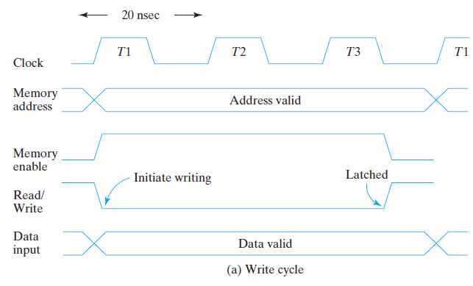
RAM - Timing Waveforms

Slide 13
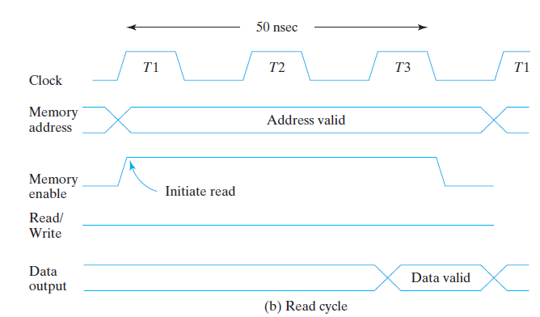
RAM - Timing Waveforms

Slide 14
Types of RAM
Mode of access
Random‐access memory - RAM
Sequential‐access memory - Magnetic disk or tape
RAM two operating modes:
Static
Dynamic
Volatile
Non-Volatile

Slide 15
Types of RAM
Static RAM (SRAM)
Latches store the binary information
The stored information remains valid as long as power is applied
Easier to use and has shorter read and write cycles
Dynamic RAM (DRAM)
Capacitors
Stores information in the form of electric charges
The stored charge tends to discharge with time
Periodically recharged by refreshing
Refreshing is done by cycling through the words every few milliseconds
DRAM offers reduced power consumption and larger storage capacity in a single memory chip

Slide 16
Types of RAM
Volatile
RAM
Memory units that lose stored information when power is turned off
The binary cells need external power to maintain the stored information
Non-Volatile
Magnetic disk, ROM, Hard disk, CD
Retains stored information after the removal of power

Slide 17
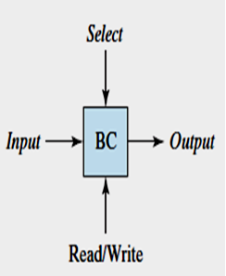
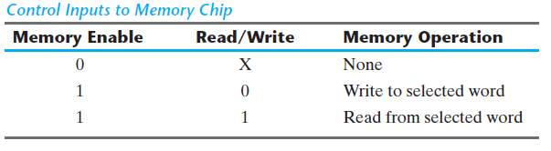
MEMORY DECODING
Same signal for read and write
Still need two control inputs
One input selects the unit
Other determines the operation

Slide 18
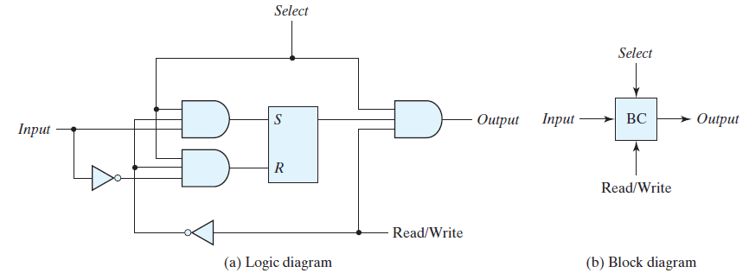
MEMORY DECODING
SR latch with associated gates form D Latch
R/W=1 read operation : Path from Latch to output
R/W=0 write operation : Path from Input to Latch

Slide 19
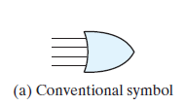
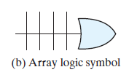
MEMORY DECODING

Slide 20
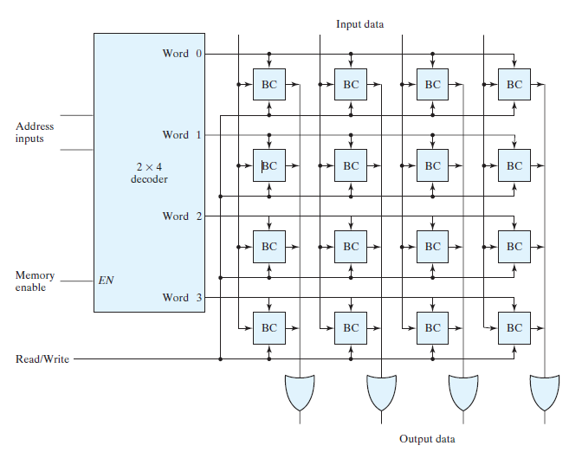
MEMORY DECODING

Slide 21
MEMORY DECODING
4 word 4 bit RAM
16 binary cells
BC represent the binary cell
BC has three inputs and one output
4 word need 2 address line
2 * 4 decoder is used to select one of the four words
Decoder has - Memory‐enable input signal
ME=0 all outputs of the decoder are 0
none of the memory words are selected
ME=1 one of the four words are selected

Slide 22
MEMORY DECODING
Once a word has been selected, the read/write input determines the operation
During the read operation, the four bits of the selected word go through OR gates to the output terminals
During the write operation, the data available in the input lines are transferred into the four binary cells of the selected word
The binary cells that are not selected are disabled
Commercial RAMs may have a capacity of thousands of words, and each word may range from 1 to 64 bits
A memory with 2^{k} words of n bits per word requires k address lines
k * 2^{k} decoder is used

Slide 23
Coincident Decoding
k inputs and 2^{k} outputs requires 2^{k} AND gates with k inputs per gate
Reduced by employing two decoders in a two‐dimensional selection scheme
Use two k/2-input decoders instead of one k-input decoder
One decoder performs the row selection and the other the column selection in a two dimensional matrix configuration

Slide 24
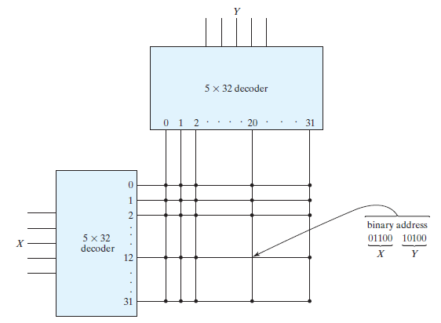
Coincident Decoding
EG:
1K‐word memory
Need 10 * 1,024 decoder in 1D
Need 1024 AND gates
10 input lines
Use two 5 * 32 decoders in 2D
Need 64 AND gates
5 input for rows
5 input for columns

Slide 25
Address Multiplexing
SRAM memory cell
Contains six transistors
To build memories with higher density - reduce the number of transistors in a cell
DRAM memory cell
Contains a single MOS transistor and a capacitor
4 times as much memory as SRAM
Cost - 4 times lesser
The charge stored on the capacitor discharges
Periodically recharged
Lower power requirement
Preferred technology for large memories in personal digital computers

Slide 26
Address Multiplexing
DRAM - two‐dimensional array
Larger memories often have multiple arrays
Pins in the IC package utilize address multiplexing
One set of address input pins accommodates the address components (Row/Columns)
Address is applied in two parts at different times
Row address first and the column address second
Since the same set of pins is used for both parts of the address, the size of the package is decreased significantly

Slide 27
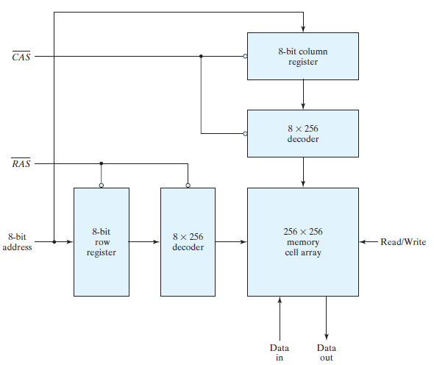
Address Multiplexing

Slide 28
Address Multiplexing
Example:
64 k word = 64 x 2¹⁰ = 2 ⁶ x 2¹⁰ = 2¹⁶ word
– RAS (Row Address Strobe) : Enable 8 bit row register
– CAS (Column Address Strobe) : Enable 8 bit column register RAS and CAS are Active low signals

Slide 29
Address Multiplexing
Initially both strobes are in 1 state
8 bit address in address line
RAS =0
Loads row address into row address register
RAS enables the Row decoder, so that it decodes the address and selects one row of the array
After sometime, (Settling time) RAS goes back to 1
8 bit address in address line
CAS =0
Loads the column address to the column address register
CAS enables the column decoder and corresponding column is selected in the array
Read / Write operation is performed on the selected cell
After certain time, CAS also goes back to 1

Slide 30
ERROR DETECTION AND CORRECTION
Storing and retrieving the binary information is erroneous due to the electrical signals affecting the data path
Error‐detecting and error‐correcting codes improves the Reliability of a memory unit
1.Common error detection scheme - parity bit
A parity bit is generated and stored along with the data word in memory
The parity of the word is checked after reading it from memory
The data word is accepted if the parity of the bits read out is correct
If the parity checked results in an inversion, an error is detected
This technique cannot correct errors

Slide 31
ERROR DETECTION AND CORRECTION
1.Common error detection scheme - parity bit
A parity bit is generated and stored along with the data word in memory
The parity of the word is checked after reading it from memory
The data word is accepted if the parity of the bits read out is correct
If the parity checked results in an inversion, an error is detected
This technique cannot correct errors
Eg : data: 1011011
generate Parity (even): 1
10110111
Check parity if parity is 1 then it is correct otherwise error

Slide 32
ERROR DETECTION AND CORRECTION
2. An error‐correcting code
Write:
Generates multiple parity check bits
Stored with the data word in memory
Each check bit is a parity over a group of bits
Read:
Read the word and associated parity bits
New set of check bits generated from the data
If the check bits are correct, no error has occurred
if the check bits do not match the stored parity, they generate a unique pattern, called a syndrome
Syndrome - used to identify the bit that is in error
A single error occurs when a bit changes in value from 1 to 0 or from 0 to 1 during the write or read operation
if the specific bit in error is identified, then the error can be corrected by complementing the erroneous bit

Slide 33
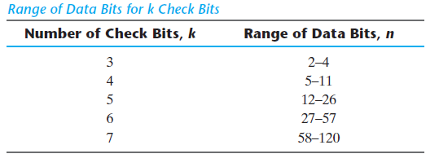
ERROR DETECTION AND CORRECTION
Hamming Code:
Devised by R.W. Hamming
n ‐bit data word
k parity bits
Form a new word of n + k bits
K=3 then n<=2³-1
(2^{k}-1) >= n+k
(2^{k}-1) –k = n
1 | 2 | 3 | 4 | 5 | 6 | 7 | 8 | 9 | 10 | 11 | 12
P1 | P2 | D | P4 | D | D | D | P8 | D | D | D | D
2⁰ | 2¹ |  | 2² |  |  |  | 2³
1 | 2 |  | 4 |  |  |  | 8

Slide 34
Hamming Code
 | c4 | c3 | c2 | c1
1 | 0 | 0 | 0 | 1
2 | 0 | 0 | 1 | 0
3 | 0 | 0 | 1 | 1
4 | 0 | 1 | 0 | 0
5 | 0 | 1 | 0 | 1
6 | 0 | 1 | 1 | 0
7 | 0 | 1 | 1 | 1
8 | 1 | 0 | 0 | 0
9 | 1 | 0 | 0 | 1
10 | 1 | 0 | 1 | 0
11 | 1 | 0 | 1 | 1
12 | 1 | 1 | 0 | 0
13 | 1 | 1 | 0 | 1
14 | 1 | 1 | 1 | 0
15 | 1 | 1 | 1 | 1
1 | 2 | 3 | 4 | 5 | 6 | 7 | 8 | 9 | 10 | 11 | 12
P1 | P2 | D | P4 | D | D | D | P8 | D | D | D | D
2⁰ | 2¹ |  | 2² |  |  |  | 2³
1 | 2 |  | 4 |  |  |  | 8
Till 12th bit
C1 = XOR of bits (1, 3, 5, 7, 9, 11)
C2 = XOR of bits (2, 3, 6, 7, 10, 11)
C4 = XOR of bits (4, 5, 6, 7, 12)
C8 = XOR of bits (8, 9, 10, 11, 12)
P1 = XOR of bits (3, 5, 7, 9, 11)
P2 = XOR of bits (3, 6, 7, 10, 11)
P4 = XOR of bits (5, 6, 7, 12)
P8 = XOR of bits (9, 10, 11, 12)

Slide 35
Hamming Code
Write :
Input Data
8‐bit data word 11000100
4 bit parity
P1 = XOR of bits (3, 5, 7, 9, 11) = (1,1,0,0,0) =0
P2 = XOR of bits (3, 6, 7, 10, 11) = (1,0,0,1,0) =0
P4 = XOR of bits (5, 6, 7, 12) = (1,0,0,0) =1
P8 = XOR of bits (9, 10, 11, 12) =(0,1,0,0) =1
 | 1 | 2 | 3 | 4 | 5 | 6 | 7 | 8 | 9 | 10 | 11 | 12
 | P1 | P2 | D | P4 | D | D | D | P8 | D | D | D | D
^{Data} |  |  | 1 |  | 1 | 0 | 0 |  | 0 | 1 | 0 | 0
Parity | 0 | 0 |  | 1 |  |  |  | 1
Hamming Code | 0 | 0 | 1 | 1 | 1 | 0 | 0 | 1 | 0 | 1 | 0 | 0

Slide 36
Hamming Code
Read :
Input Data
8‐bit data word 001110010100
C1 = XOR of bits (1, 3, 5, 7, 9, 11) = (0,1,1,0,0,0) = 0
C2 = XOR of bits (2, 3, 6, 7, 10, 11) = (0,1,0,0,1,0) =0
C4 = XOR of bits (4, 5, 6, 7, 12) =(1,1,0,0,0) =0
C8 = XOR of bits (8, 9, 10, 11, 12) = (1,0,1,0,0) =0
C= C8C4C2C1 = 0000= No Error
 | 1 | 2 | 3 | 4 | 5 | 6 | 7 | 8 | 9 | 10 | 11 | 12
 | P1 | P2 | D | P4 | D | D | D | P8 | D | D | D | D
^{Data} | 0 | 0 | 1 | 1 | 1 | 0 | 0 | 1 | 0 | 1 | 0 | 0
Parity check | 0 | 0 |  | 0 |  |  |  | 0

Slide 37
Hamming Code
Error correction
Data |  | C8C4C2C1 | Corrected data
001110010100 | No error | 0000 | 001110010100
101110010100 | Error in bit 1 | 0001 | 001110010100
001100010100 | Error in bit 5 | 0101 | 001110010100

Slide 38
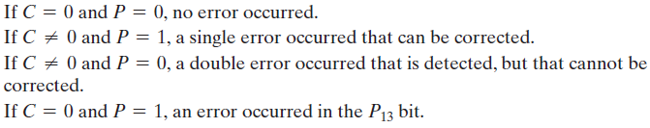
Hamming Code
Single Error correction and double error detection
Adding another parity bit to the coded word - P13
P13 is XOR of the all other 12 bits
001110010100 = P13 = 1
0011100101001 (even parity)
P is a check for even parity P= XOR of all 13 bits
If P = 0, the parity is correct,
If P = 1, then parity is incorrect

